Slide 1

Computer Architecture
A Quantitative Approach
Chapter 2 and Appendix B
Memory Hierarchy Design

Slide 2
MEMORY HIERARCHY INTRO
- Chapter 2 and Appendix B

Slide 3
Motivation
Programmers want unlimited amounts of memory with low latency
Fast memory technology is more expensive per bit than slower memory
Solution: organize memory system into a hierarchy
  Entire addressable memory space available in largest,
  slowest memory
  Incrementally smaller and faster memories, each containing a subset of the memory below it, proceed in steps up toward the processor
Temporal and spatial locality ensures that nearly all references can be found in smaller memories
  Gives the allusion of a large, fast memory being presented to the processor

Slide 4

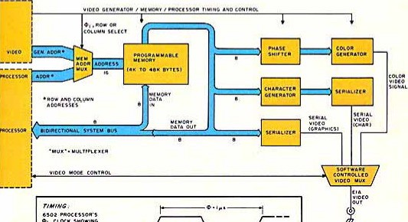
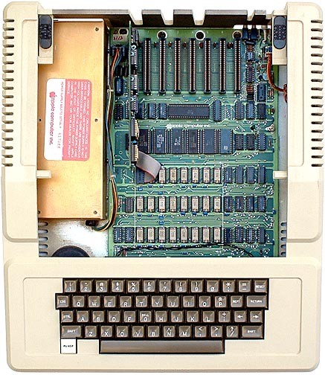




1977: DRAM faster than microprocessors
Apple II (1977) Latencies
CPU clock: ~1000 ns
DRAM access: 400 ns
Steve
Steve Jobs
Wozniak
Notes:
>>
In 1976 & 1977,
the DRAM in the Apple I and Apple II computers operated faster than the microprocessor,
a situation that was common at the time.
The Apple I’s
CPU had a cycle time of 1000 nanoseconds (~1 MHz clock speed MOS 6502),
while its DRAM had an access time of 400 or 500 nanoseconds,
making the DRAM significantly faster than the CPU.
The period when memory was faster than microprocessors was brief,
and the Apple II's design reflects the shift toward optimizing memory bandwidth for computation.
Optional:
The Apple II's architecture,
including the integration of DRAM refresh into the video refresh cycle,
was a direct consequence of the period when memory was faster than the microprocessor.

Slide 5
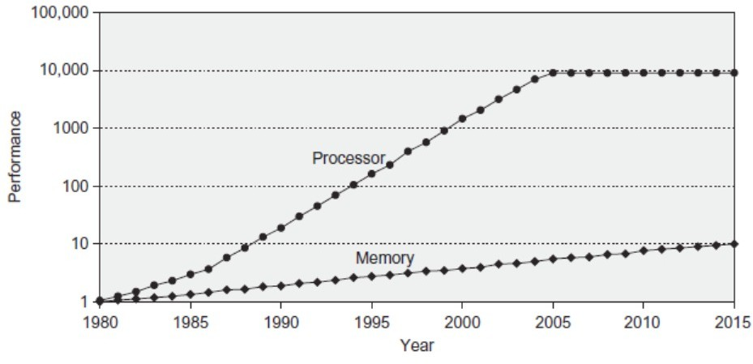
Since 1980, CPU has outpaced DRAM ...
Q. How do computer architects address this gap?
A. Put smaller, faster “cache” memories between CPU and DRAM. Create a “memory hierarchy”.
Latency gap grew 50% per year
5
Notes:
>>
Since 1980, the performance of CPUs has significantly outpaced that of DRAM,
leading to a growing processor-memory performance gap.
This gap has been increasing at a rate of approximately 50% per year,
primarily due to better CPU speed improvements,
and marginal improvements in DRAM access times,
(with limited advancements in memory latency being a major factor.)
Q. How do computer architects address this gap?
A. Put smaller, faster “cache” memories between CPU and DRAM.
Create a “memory hierarchy”.

Slide 6
Memory Hierarchy Design
Memory hierarchy design becomes more crucial with recent multi-core processors:
  Aggregate peak bandwidth grows with # of cores:
» Intel Core i7 6700 (Released in 2015)
can generate two memory references per core per clock
» Four cores and 42.2 GHz clock
    25.6 billion 64-bit data memory references / second +
    12.8 billion 128-bit instruction references / second
Results in a bandwidth of 409.6 GB/s!
» Achieved by
    Multi-port, pipelined caches
    Two levels of cache per core
    Shared third-level cache on chip
» DRAM bandwidth is only 8% of this (34.1 GB/s)
Notes:
…
Four cores and 42.2 GHz clock:
BW = (25.6 * 10^9 * 8 bytes)/s + (12.8 * 10^9 * 16 bytes)/s
BW = (204.8 + 204.8) * 10^9 bytes/s
BW = 409.6 GB/s
For reference:
Intel Core i7-6700 generating two references per core per clock
relates to memory-level parallelism
and memory bandwidth utilization in multi-core processors.

Slide 7
Performance and Power
High-end microprocessors have >10 MB on-chip cache
– Consumes large amount of area and power budget

Slide 8
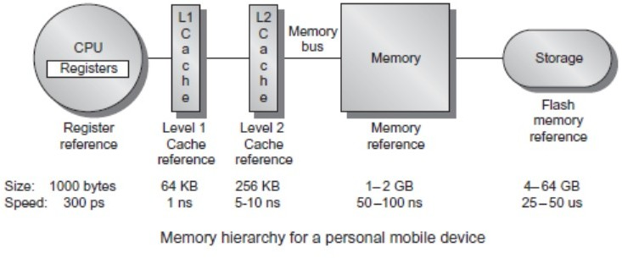
Memory Hierarchy in Modern Systems
Notes:
>>
A typical memory hierarchy in a personal mobile device (PMD),
such as a cell phone or tablet,
consists of multiple levels organized by speed, size, and cost,
with faster and smaller memory closer to the processor
and slower, larger, and cheaper memory farther away.
The hierarchy typically includes:
registers
cache (L1, L2, and sometimes L3)
main memory (RAM)
and secondary storage
which in PMDs is Flash memory built from EEPROM technology rather than traditional hard disk drives.
EEPROM: electrically erasable programmable read-only memory

Slide 9
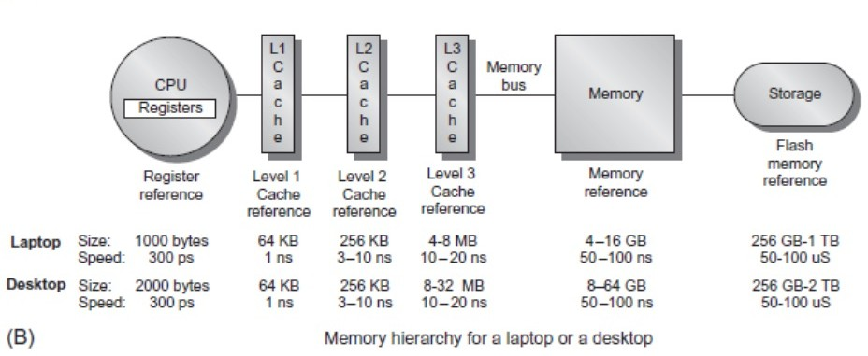
Memory Hierarchy in Modern Systems
Notes:
>>
The typical memory hierarchy for a laptop or desktop computer
consists of multiple levels, ordered from fastest and smallest to slowest and largest.
Cache memory, is divided into three primary levels: L1, L2, and L3.
L1 cache is the fastest and smallest, located directly on the CPU core,
and is used to store the most frequently accessed data and instructions.
L2 cache is larger than L1 but slightly slower, and it acts as a secondary buffer,
also located on the CPU chip or nearby.
L3 cache is the largest of the three, shared among multiple CPU cores in a multicore processor,
and is slower than L1 and L2 but helps reduce latency when data is not found in the faster caches.
(Recent advancements have even introduced L4-level cache in some high-end processors.)
Below the cache levels is main memory (RAM),
which is significantly larger than cache
and used to store data and programs currently in use.
RAM is volatile,
meaning data is lost when power is turned off,
and it is slower than cache but faster than secondary storage.
Solid-state drives (SSDs) are now standard in modern
laptops and desktops, serving as the primary secondary storage.
In many desktops, the primary storage system is SSD,
and expansion disks are typically hard disk drives (HDDs).

Slide 10
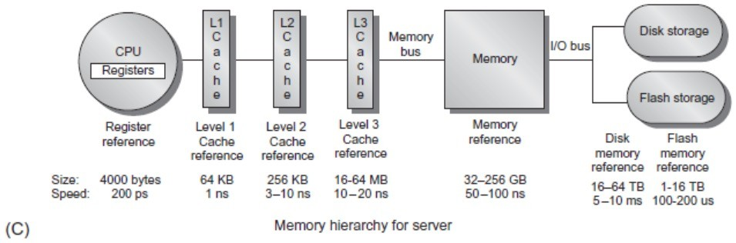
Memory Hierarchy in Modern Systems
Notes:
>>
Here is a typical memory hierarchy for a server.
Modern servers often use a tiered or hybrid approach to storage,
mixing SSDs and HDDs to optimize performance and cost.
For example,
SSDs can be used as a high-speed cache for HDDs,
accelerating both reads and writes by storing frequently accessed ("hot") data,
while less frequently accessed ("cold") data resides on HDDs.

Slide 11
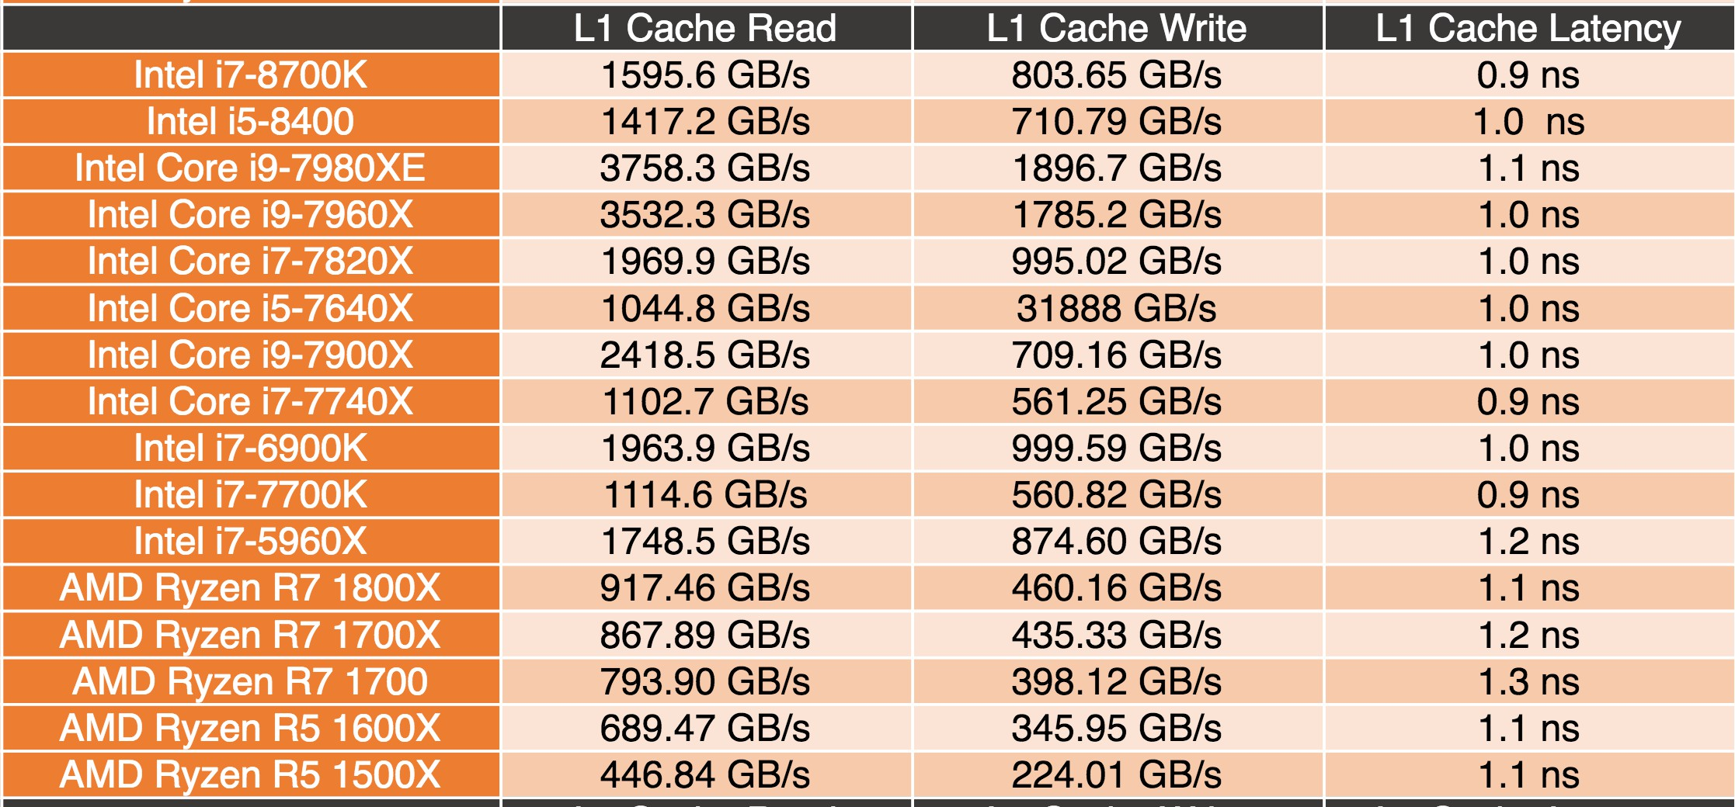
L1 Cache Latency
(Intel 8th Gen Core CPUs – Coffee Lake, announced on 2017)
Data from https://lanoc.org
Notes:
0.9 to 1.3 ns latency for L1 Cache (2017)

Slide 12
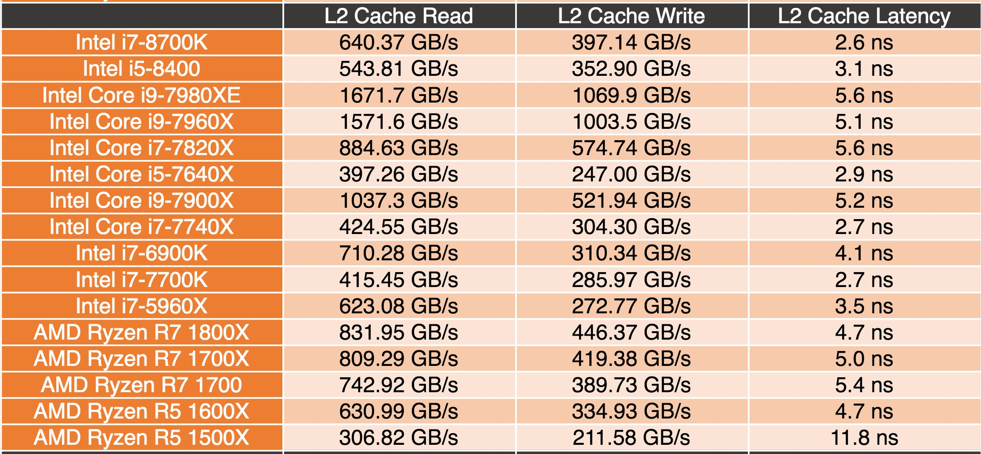
L2 Cache Latency
(Intel 8th Gen Core CPUs – Coffee Lake)
Data from https://lanoc.org
Notes:
2.6 to 5.6 ns latency for L2 Cache (2017)

Slide 13
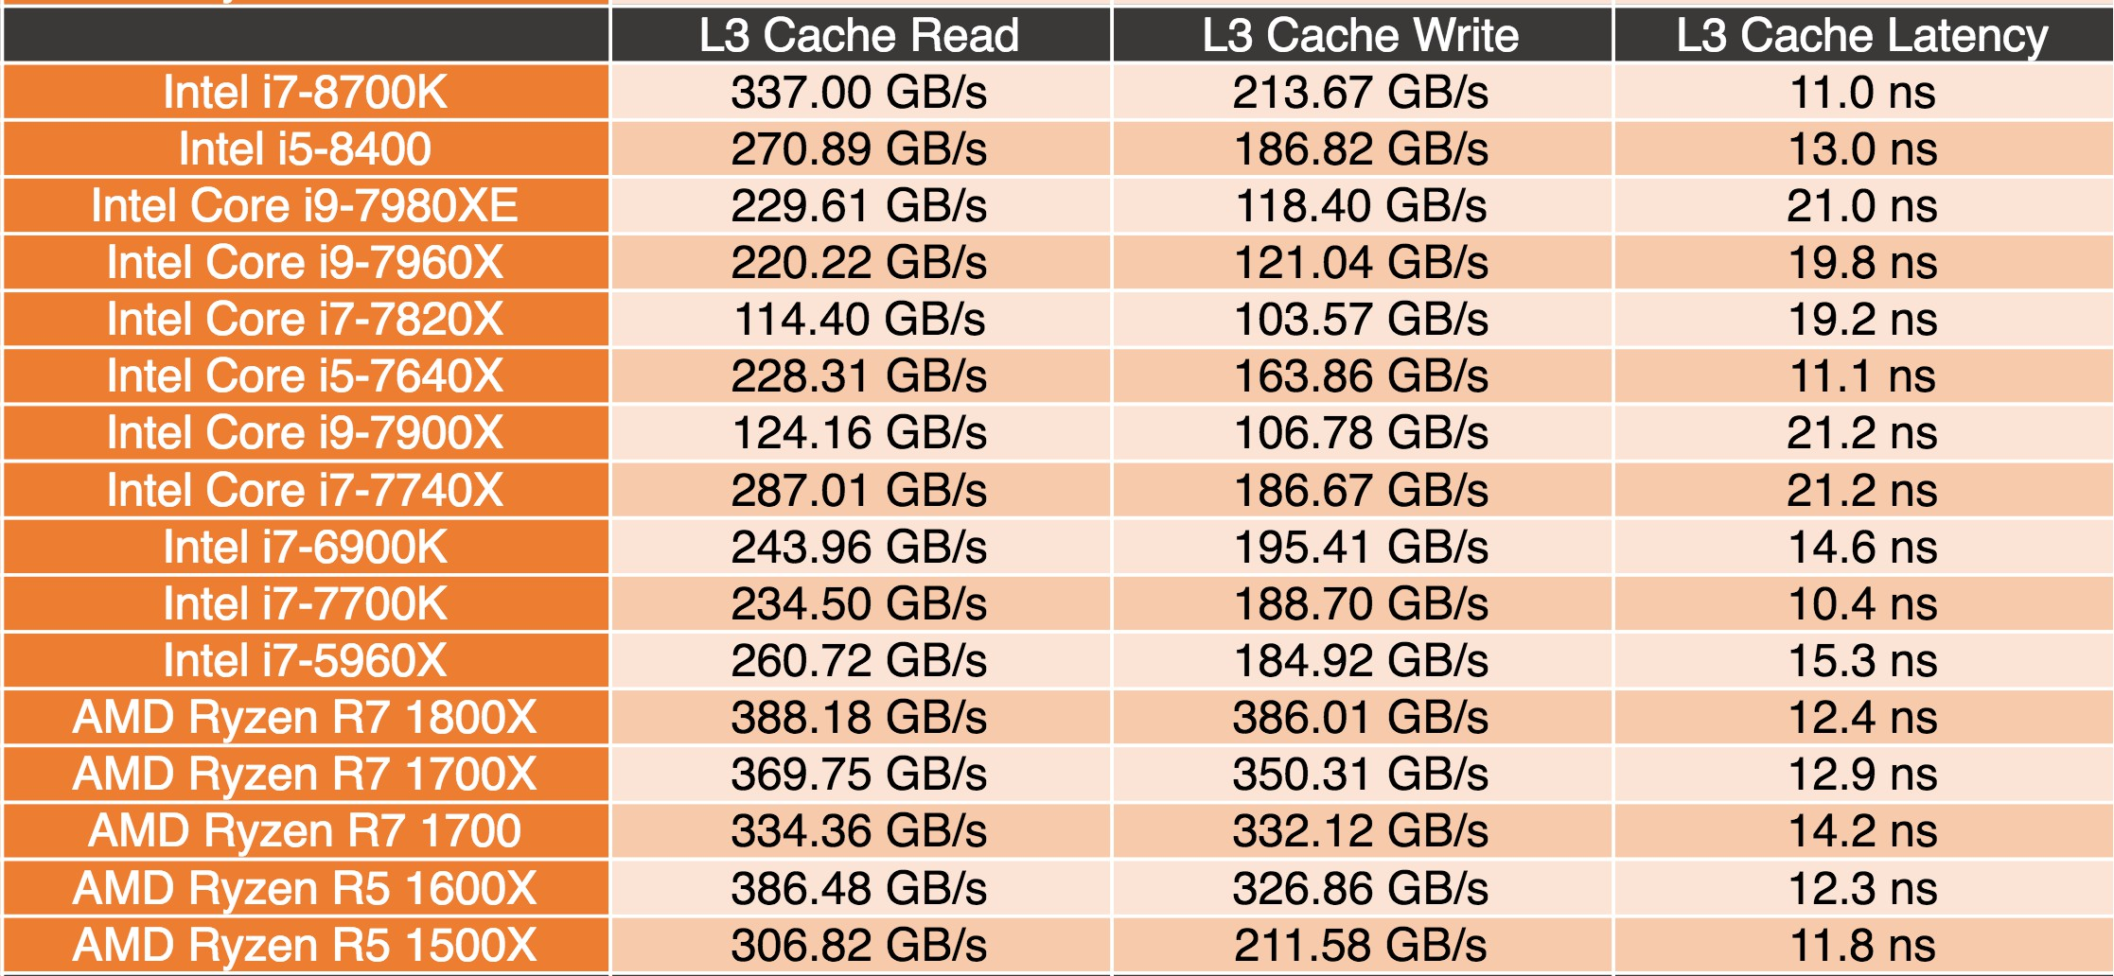
L3 Cache Latency
(Intel 8th Gen Core CPUs – Coffee Lake)
Data from https://lanoc.org
Notes:
11.0 to 21.2 ns latency for L3 Cache (2017)

Slide 14
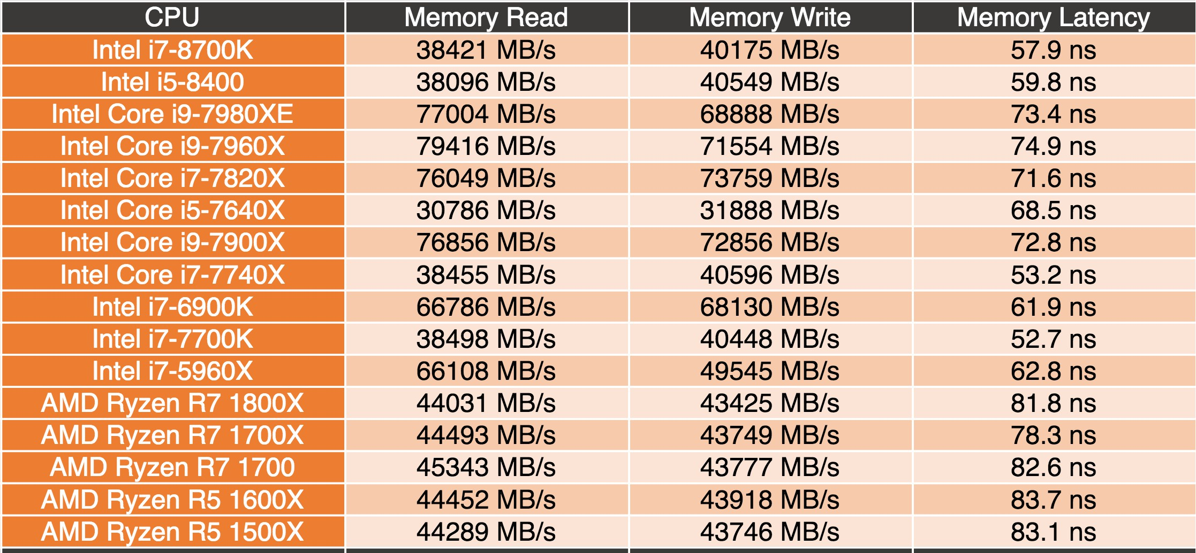
Memory Latency
(Intel 8th Gen Core CPUs – Coffee Lake)
Data from https://lanoc.org
Notes:
53.2 to 83.7 ns latency for DRAM Main Memory (2017)

Slide 15

Memory Hierarchy: Apple iMac G5 (2004-5)
Utilized by compiler
Managed by hardware
Managed by OS, hardware, application
1977+27yr
Reg
L1 Inst
L1 Data
L2
DRAM
Disk
Size in Bytes
1K
64K
32K
512K 256M 80G
Latency in Cycles, Time
iMac G5
1.6 GHz
1600x (mem: 7.3x) Apple II
1 cyc,
0.6 ns
3 cyc,
1.9 ns
3 cyc,
1.9 ns
11 cyc,
6.9 ns
88 cyc,
55 ns
10⁷ cyc,
12 ms
Goal: Illusion of large, fast, cheap memory
Let programs address a memory space that scales to the disk size, at a speed that is usually nearly as fast as register access
iMac G5 1.6 GHz clock, 55 ns DRAM vs. Apple II 1 MHz, 400ns DRAM Perform: CPU 1600 X, DRAM 7.3 X faster in 27 yrs => 2X/ 2.5y, 9.3y
Notes:
…
The goal is to create an illusion of large, fast, cheap memory.

Slide 16
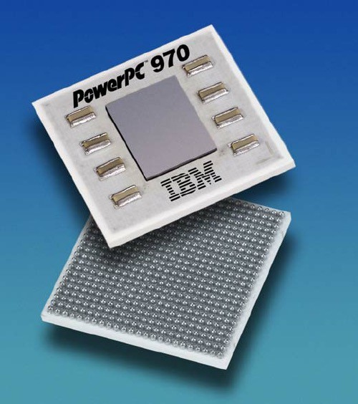
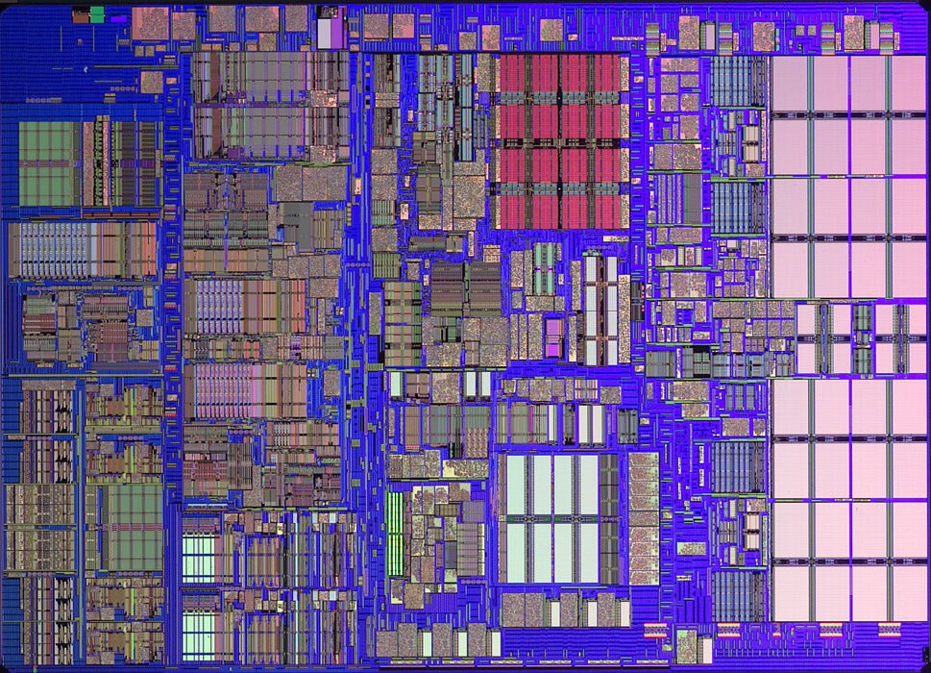
iMac’s PowerPC 970 (G5): All caches on-chip
L1 (64K Instruction)
1/2 KB
registers
L2 512K
1/2 KB
registers
L1 (32K Data)
Notes:
>>
The PowerPC 970 (G5) used in the iMac G5 features on-chip caches,
specifically, a 64 KB L1 instruction cache and a 32 KB L1 data cache,
both located on the processor die.
The processor also includes a 512 KB L2 cache that is on-chip.
There is no L3 cache present in the 970 (G5) processor.
Therefore, all primary caches (L1 and L2) are on-chip.

Slide 17
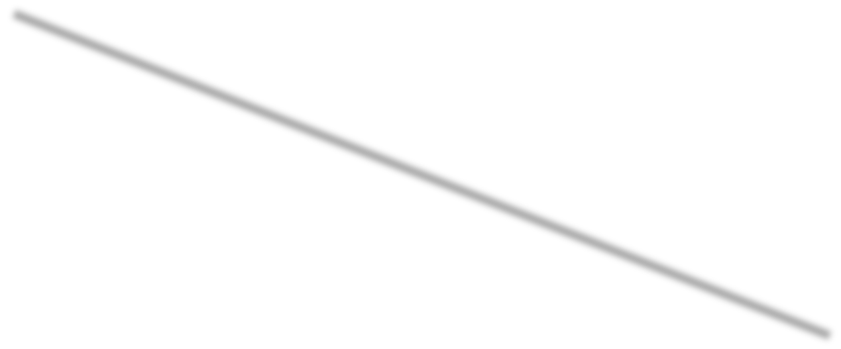

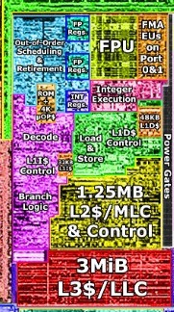
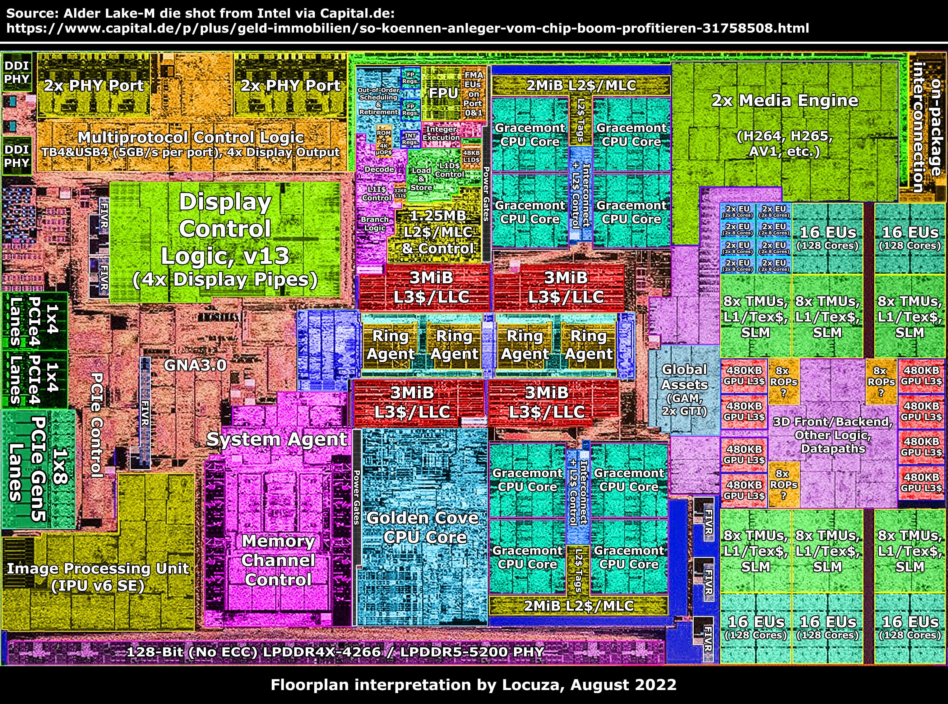
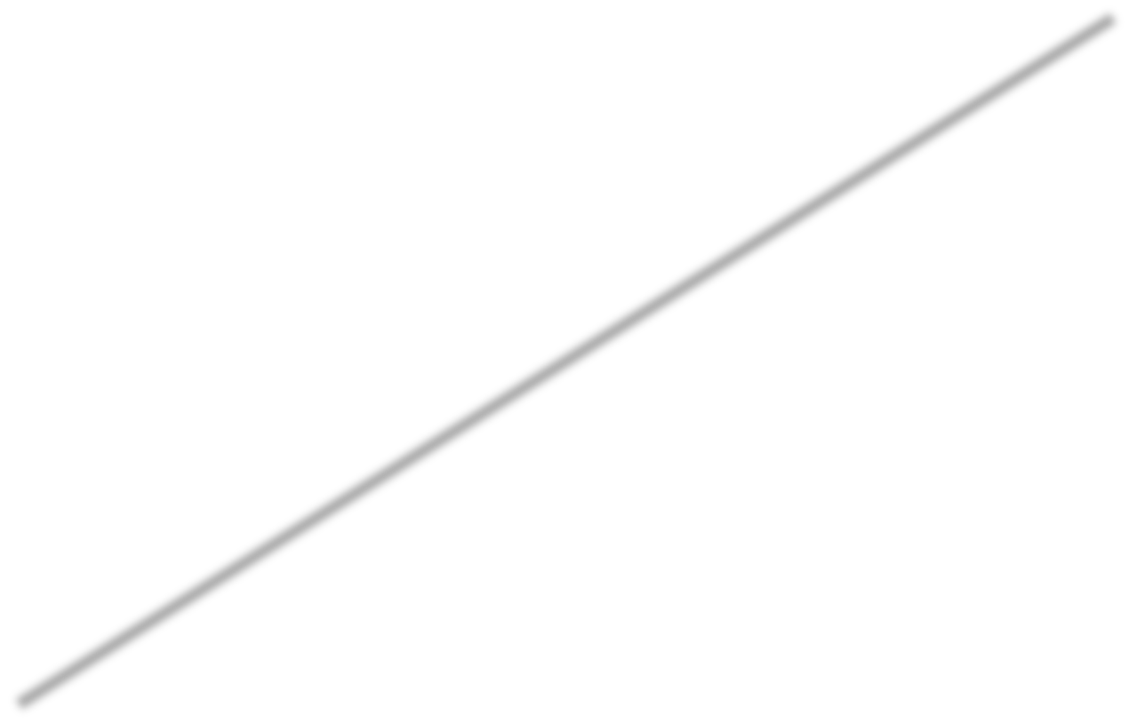

A floorplan interpretation
Intel Alder Lake (2022)
Source: https://locuza.substack.com/p/info-snack-alder-lake-m-raptor-lake

Slide 18
MEMORY HIERARCHY
- Chapter 2 and Appendix B

Slide 19
The Principle of Locality
The Principle of Locality
  Program access a relatively small portion of the address space at any instant of time.
Two Different Types of Locality
  Temporal Locality (Locality in Time): If an item is referenced, it will tend to be referenced again soon (e.g., loops, reuse)
  Spatial Locality (Locality in Space): If an item is referenced, items whose addresses are close by tend to be referenced soon
(e.g., straightline code, array access)
It is a property of programs that is exploited in machine design.
  For last 3 decades, HW has relied on locality for speed by using fast cache copies of memory parts to lower the
  Average Memory Access Time (AMAT) for programs
Notes:
>>
The Principle of Locality (also known as locality of reference) states
that programs access a relatively small portion of their address space at any instant of time.
This principle is fundamental to computer system design,
as it enables the creation of hierarchical memory systems
that optimize performance by leveraging predictable access patterns.
There are two different types of locality:
Temporal Locality: …
Spatial Locality: …
This principle is observed in straight-line code
that processes data structures like arrays in a loop,
where elements are accessed in order,
such as in a for loop iterating through an array.
Optional:
(Array access: accessing consecutive memory locations in a sequential manner)
(Straightline code: emphasizes that related code and data should be grouped together to improve readability and ease of navigation.)
…

Slide 20
What is cache memory? Main memory first
Main memory is divided into small blocks
Each block contains many words (32-256 common now)
Notes:
>>
When talking about cache memory,
Let’s first look at main memory.

Slide 21
Main memory
Blocks are grouped into frames (physical pages),
3 frames in this picture.
Blocks are addressed by their frame number, and their block number within the frame.
0 0 | 0 1 | 0 2 | 0 3 | 0 4 | 0 5 | 0 6 | 0 7 | 1 0 | 1 1 | 1 2 | 1 3 | 1 4 | 1 5 | 1 6 | 1 7 | 2 0 | 2 1 | 2 2
21

Slide 22
Cache memory
Cache has many, MANY fewer blocks than main memory, each with
a block number,
a memory address (octal, in this slide)
data
a valid bit, (initially, 0)
a dirty bit
0 | 1 | 2 | 3 | 4 | 5 | 6 | 7
10 | 21 | 42 | 53 | 74 | 25 | 16 | 77
0 | 0 | 0 | 0 | 0 | 0 | 0 | 0
0 | 0 | 0 | 0 | 0 | 0 | 0 | 0
22

Slide 23
Issues to consider
How big should the fastest memory (cache) be?
How do we decide what to put in cache memory?
If the cache is full, how do we decide what to remove?
How do we find something in cache?
How do we handle writes?
Notes:
>>
Q. How big should the fastest memory (cache) be?
A. Depends on the cost.
Q. How do we decide what to put in cache memory?
A. Frequently accessed memory objects
Q. If the cache is full, how do we decide what to remove?
A. Cache replacement policies
Q. How do we find something in cache?
A. Depends on how it is organized
Q. How do we handle writes?
A. Cache write policies

Slide 24
How does cache memory work?
The following slides discuss:
  What cache memory is
  Three organizations for cache memory
» direct mapped
» set associative
» fully associative
  How the bookkeeping is done
Important note on memory address representation
– All addresses shown are in octal in this lecture example. Addresses in the book are usually decimal.
In reality, they are binary.
Notes:
Direct-mapped cache: one block per set
Set associative: n sets => n-way set associative
Fully associative: one set

Slide 25

Cache: Memory address partition
Each address of a memory location is partitioned into
  Block address
    » Tag
    » Index
  Block offset
Fig. B.3
Fig. 5.5

Slide 26
Cache memory (cont.)
Initially, all the valid bits set to zero.
0 | 1 | 2 | 3 | 4 | 5 | 6 | 7
10 | 21 | 42 | 53 | 74 | 25 | 16 | 77
0 | 0 | 0 | 0 | 0 | 0 | 0 | 0
0 | 0 | 0 | 0 | 0 | 0 | 0 | 0

Slide 27
Cache memory (cont.)
Suppose want to load block 14 (octal) from memory into cache.
Three ways to organize cache
direct mapped
set associative
fully associative
0 | 1 | 2 | 3 | 4 | 5 | 6 | 7
10 | 21 | 42 | 53 | 74 | 25 | 16 | 77
0 | 0 | 0 | 0 | 0 | 0 | 0 | 0
0 | 0 | 0 | 0 | 0 | 0 | 0 | 0
27

Slide 28





Direct mapped cache
In direct mapped cache, block 14 can only be put in the cache block with address 4.
So, the cache will no longer hold the block with memory address 74.
0 | 1 | 2 | 3 | 4 | 5 | 6 | 7
10 | 21 | 42 | 53 | 74 | 25 | 16 | 77
0 | 0 | 0 | 0 | 0 | 0 | 0 | 0
0 | 0 | 0 | 0 | 0 | 0 | 0 | 0
28
Notes:
(Direct-mapped cache: one block per set)
Memory address: 14 (octal) = 1100 (binary)
1100 & 111 (or mod 7) = 100 (binary) = block number 4

Slide 29





Direct mapped cache (cont.)
After the load, the contents look like this.
0 | 1 | 2 | 3 | 4 | 5 | 6 | 7
10 | 21 | 42 | 53 | 14 | 25 | 16 | 77
0 | 0 | 0 | 0 | 1 | 0 | 0 | 0
0 | 0 | 0 | 0 | 0 | 0 | 0 | 0

Slide 30










Set associative cache
Mapping Rule: Block Number % (Number of Sets)
Set 0 Set 1 Set 2 Set 3
Set: a group of blocks in the
cache. A block is first mapped onto a set and then it can be placed anywhere within that set.
For example, if divide cache into 4 sets, block 14 (octal) can be put in any block in Set 0 (since last two bits of 14 octal are zero).
0 | 1 | 2 | 3 | 4 | 5 | 6 | 7
10 | 24 | 41 | 55 | 72 | 26 | 13 | 77
0 | 0 | 0 | 0 | 0 | 0 | 0 | 0
0 | 0 | 0 | 0 | 0 | 0 | 0 | 0
Notes:
(n sets => n-way set associative)
14 (octal) = 1100 (binary)
2-way set associative
Index size: 2 bits (for 4 sets 0 through 3)
1100 & 11 = 0 = Set 0

Slide 31





Set associative cache (cont.)
Set 0
Set 1
Set 2
Set 3
So, after loading the block, cache memory might look like this.
0 | 1 | 2 | 3 | 4 | 5 | 6 | 7
14 | 24 | 41 | 55 | 72 | 26 | 13 | 77
1 | 0 | 0 | 0 | 0 | 0 | 0 | 0
0 | 0 | 0 | 0 | 0 | 0 | 0 | 0

Slide 32





Set associative cache (cont.)
Set 0 Set 1 Set 2 Set 3
Note that the last two bits of the memory block address always match the set number, so do not need to be stored. This part of the address is called the index.
The higher order bits are stored and are called the tag.
0 | 1 | 2 | 3 | 4 | 5 | 6 | 7
14 | 24 | 41 | 55 | 72 | 26 | 13 | 77
1 | 0 | 0 | 0 | 0 | 0 | 0 | 0
0 | 0 | 0 | 0 | 0 | 0 | 0 | 0
Recall:
Notes:
(n sets => n-way set associative)
14 (octal) = 1100 (binary)
2-way set associative
Index size: 2 bits (for 4 sets 0 through 3)
1100 & 11 = 0 = Set 0

Slide 33
Set associative cache replacement
Which entry in the set to replace?
Three common choices:
  Replace an eligible random block
  Replace the least recently used (LRU) block
» can be hard to keep track of, so often only approximated
  Replace the oldest eligible block (First In, First Out, or FIFO)

Slide 34





Fully associative cache
In fully associative cache, memory blocks may be stored anywhere.
So, block 14 might be put in the first available block -- one with valid = 0.
i.e., a single 8-way set
eight 1-way sets,
if direct-mapped cache
0 | 1 | 2 | 3 | 4 | 5 | 6 | 7
10 | 21 | 42 | 53 | 74 | 25 | 16 | 77
0 | 0 | 0 | 0 | 0 | 0 | 0 | 0
0 | 0 | 0 | 0 | 0 | 0 | 0 | 0
Notes:
(Fully associative: one set)

Slide 35
Fully associative cache
With this result.
0 | 1 | 2 | 3 | 4 | 5 | 6 | 7
14 | 21 | 42 | 53 | 74 | 25 | 16 | 77
1 | 0 | 0 | 0 | 0 | 0 | 0 | 0
0 | 0 | 0 | 0 | 0 | 0 | 0 | 0

Slide 36

Review Questions
How many bits in a memory address are used for the block offset field, when cache block size is 32 bytes?
Continued from the question above, If the cache contains 1K blocks and it’s 2-way set associative, how many bits are used for index?
Continued from the question above, if the system uses 40 bits for a physical memory address, how many bits are used for tag?
Notes:
Block size: 32 bytes
Block offset: log2(32) bits = log2(2^5) bits = 5 bits
Number of blocks: 1K blocks = 1024 blocks
2-way set associative cache
Number of sets: 1024 / 2 = 512 sets
Index size: log2(512) bits = log2(2^9) bits = 9 bits
Physical memory address: 40 bits
Tag size: 40 – 9 – 5 = 26 bits

Slide 37
MEMORY HIERARCHY
- Chapter 2 and Appendix B

Slide 38
Cache: Memory address partition
Each address of a memory location is partitioned into
  Block address
    » Tag
    » Index
  Block offset
Fig. B.3
Fig. 5.5

Slide 39
Memory Hierarchy: Terminology
Hit: data appears in some block in the upper level
  Hit Rate: the fraction of memory accesses found in the upper level
  Hit Time: Time to access the upper level which consists of
» Time to determine hit/miss
Miss: data needs to be delivered from a block in the lower level
  Miss Rate = 1 - (Hit Rate)
  Miss Penalty: Time to replace a block in the upper level + Time to deliver the block to the upper level
Hit Time ≪ Miss Penalty
Lower Level Large Size Memory
Blk Y
To Processor
Upper Level Memory
Blk X
From Processor

Slide 40
Managing cache
Use direct mapped cache as an example.
After first read operation, cache memory looked like this.
0 | 1 | 2 | 3 | 4 | 5 | 6 | 7
10 | 21 | 42 | 53 | 14 | 25 | 16 | 77
0 | 0 | 0 | 0 | 1 | 0 | 0 | 0
Valid Dirty
0 | 0 | 0 | 0 | 0 | 0 | 0 | 0

Slide 41
Managing cache (cont.)
If all other memory references involved block 14, no other blocks would need to be fetched from memory.
But suppose eventually need to access blocks 10, 31 and 66.
0 | 1 | 2 | 3 | 4 | 5 | 6 | 7
10 | 21 | 42 | 53 | 14 | 25 | 16 | 77
Need to fetch all three, because we don’t have valid versions of them in cache.
Valid Dirty
0 | 0 | 0 | 0 | 1 | 0 | 0 | 0
0 | 0 | 0 | 0 | 0 | 0 | 0 | 0

Slide 42
Managing cache (cont.)
0 | 1 | 2 | 3 | 4 | 5 | 6 | 7
The result looks like this.
Now suppose write to block 66 and 31.
10 | 31 | 42 | 53 | 14 | 25 | 66 | 77
1 | 1 | 0 | 0 | 1 | 0 | 1 | 0
Valid Dirty
0 | 0 | 0 | 0 | 0 | 0 | 0 | 0

Slide 43
Managing cache (cont.)
The blocks are valid in cache, so don’t need to fetch them again.
But the write operation sets the dirty bit for the blocks.
0 | 1 | 2 | 3 | 4 | 5 | 6 | 7
10 | 31 | 42 | 53 | 14 | 25 | 66 | 77
1 | 1 | 0 | 0 | 1 | 0 | 1 | 0
Valid Dirty
0 | 1 | 0 | 0 | 0 | 0 | 1 | 0

Slide 44





Managing cache (cont.)
0 | 1 | 2 | 3 | 4 | 5 | 6 | 7
Now suppose CPU needs to read data in a block not in cache.
10 | 31 | 42 | 53 | 14 | 25 | 66 | 77
If it is block 41, then must overwrite block 31.
1 | 1 | 0 | 0 | 1 | 0 | 1 | 0
Valid Dirty
0 | 1 | 0 | 0 | 0 | 0 | 1 | 0

Slide 45




Write-through cache
In write-through caches, every write causes an immediate change both to cache and to main memory.
So, the read just involves fetching the block.
0 | 1 | 2 | 3 | 4 | 5 | 6 | 7
10 | 31 | 42 | 53 | 14 | 25 | 66 | 77
1 | 1 | 0 | 0 | 1 | 0 | 1 | 0
Valid
Notes:
Immediately update lower levels of hierarchy.

Slide 46





Write-back cache
In write-back caches, every write causes a change only to cache.
0 | 1 | 2 | 3 | 4 | 5 | 6 | 7
10 | 41 | 42 | 53 | 14 | 25 | 66 | 77
So, the read involves writing block 31 back to memory because its dirty bit is set, then fetching block 41.
1 | 1 | 0 | 0 | 1 | 0 | 1 | 0
Valid Dirty
0 | 0 | 0 | 0 | 0 | 0 | 1 | 0

Slide 47
Cache Measures
Hit rate: fraction of blocks found in that level
  So high that usually talk about Miss rate = 1 - Hit rate
  Miss rate fallacy: as MIPS to CPU performance,
  miss rate to AMAT in memory
AMAT = Hit time + Miss rate x Miss penalty (ns or clocks)
Miss penalty: time to supply a missed block from lower level, including any CPU-visible delays to save replaced write-back data to make room in upper-level cache. {“All active caches are full”}
  access time: time to lower level = f (latency to lower level)
  transfer time: time to transfer block = f (BW between upper & lower levels)
  replacement time: time to make upper-level room for new block, if all active caches are full
Notes:
…
The miss rate fallacy refers to
the misconception that a lower cache miss rate alone guarantees better overall system performance,
similar to how higher instructions per second is often incorrectly assumed to directly equate to superior CPU performance.
(MIPS: Millions of Instructions Per Second)

Slide 48
How much do stalls slow a machine?
Suppose that on pipelined MIPS, each instruction takes, on average, 2 clock cycles, not counting cache faults/misses
Suppose, on average there are 1.33 memory references per instruction, memory access time is 50 cycles, and the miss rate is 2%
Assume 0 cycle hit time
Then each instruction takes, on average:
2
2 + (0 × .98)
2 + (0 × .98) + (1.33 × .02 × 50)
2 + (0 × .98) + (1.33 × .02 × 50) = 3.33 clock cycles
Notes:
AMAT = Hit time + Miss rate x Miss penalty (ns or clocks)
2 cycles per instruction
1.33 memory references per instruction
50 cycles memory access time
2% miss rate
98% hit rate
0 cycle hit time
Then each instruction takes, on average:
2 + (0 ∗ .98) + (1.33 ∗ .02 ∗ 50) = 3.33 clock cycles

Slide 49
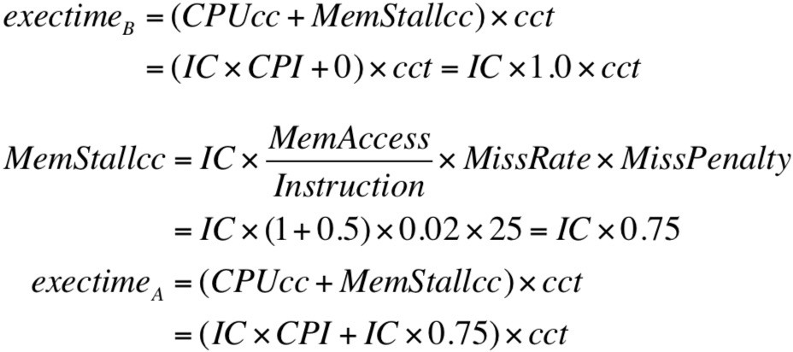
Another example
Assumption on computer A
  CPI = 1.0 when all memory accesses are hits (i.e., no penalty)
  Data accesses are only loads and stores (assume 50% of insts)
  Miss penalty: 25 cc
  Miss rate: 2%
Compute the speedup of computer B,
for which all cache accesses are hits
Notes:
execTime
= (CPUcc + MemStallcc) * cct
= (IC * CPI + MemStallcc) * cct
For computer B:
execTimeB
= (IC * CPI + MemStallcc) * cct
= (IC * 1.0 + 0) * cct
= IC * 1.0 * cct
For computer A:
MemStallcc
= IC * (MemAccess / Inst) * MissRate * MissPenalty
= IC * (1 + 0.5) * 0.02 * 25 = IC * 0.75
execTimeA
= (IC * CPI + IC * 0.75) * cct
= IC * 1.75 * cct

Slide 50

Another example
Assumption on computer A
  CPI = 1.0 when all memory accesses are hits (i.e., no penalty)
  Data accesses are only loads and stores (assume 50% of insts)
  Miss penalty: 25 clock cycles (cc)
  Miss rate: 2%
Compute the speedup of computer B,
for which all cache accesses are hits
Notes:
execTime
= (CPUcc + MemStallcc) * cct
= (IC * CPI + MemStallcc) * cct
MemStallcc
= IC * (MemAccess / Inst) * MissRate * MissPenalty
= IC * (1 + 0.5) * 0.02 * 25 = IC * 0.75
execTimeA
= (IC * CPI + IC * 0.75) * cct
= IC * 1.75 * cct
Speedup = execTimeA / execTimeB = 1.75 / 1.0 = 1.75

Slide 51
Six basic cache optimizations
Larger block size
  Reduces compulsory misses
  Increases capacity and conflict misses, increases miss penalty
Larger total cache capacity to reduce miss rate
  Increases hit time, increases power consumption
Higher associativity
  Reduces conflict misses
  Increases hit time, increases power consumption
Higher number of cache levels
  Reduces overall memory access time
Giving priority to read misses over writes
  Reduces miss penalty
Avoiding address translation in cache indexing
  Reduces hit time

Slide 52
Write through vs. write back
Which is better? | Write-Through | Write-Back
Policy | Data word written to cache block is also written to next lower-level memory Example, instr. sw to L1$ also goes to L2$ | Write new data word only to 1 cache block Update lower level just before a written block leaves cache, so not lose true value
Debugging | Easier | Harder
Can read misses force writes? | No | Yes (used to slow some reads; now write-buffer)
Do repeated writes touch lower level? | Yes, memory busier | No
Write-miss strategies
-- let writes to an un-cached address allocate a new
cache line (“write-allocate”), or just write through (“write-no-allocate”).
Notes:
Write-through and write-back are two distinct cache write strategies used to manage data consistency between a cache and a backing store.
In write-through caching,
every write operation is synchronously written to both the cache and the backing store immediately,
ensuring data consistency but at the cost of higher write latency.
Write-back caching (also known as write-behind)
writes data only to the cache initially,
deferring the update to the backing store until the cache line is evicted or replaced.
This approach uses a write to queue the asynchronous writes to the backing store,
allowing the system to continue processing without waiting for the slower storage operation.
Write-back cache significantly reduces write latency,
but introduces a risk of data loss if a failure occurs before the data is written to the backing store.
For write-miss strategies,
the decision to allocate a cache line on a write miss is governed by write-allocate and no-write-allocate policies.
Write-allocate means that when a write miss occurs,
the system fetches the corresponding block from main memory into the cache before performing the write operation.
(This is often used in conjunction with write-back policies.)
No-write-allocate (also known as write-around)
means that on a write miss, the data is written directly to main memory without being loaded into the cache.

Slide 53
Review Question
A 2-way set associative cache of size 2KB consists of blocks of the size 32 bytes.
– Tags and admin bits are not considered in the 2KB.
Suppose that a physical memory address has 32 bits.
What is the size (bits) of the block offset in the address?
Notes:
2-way set associative cache
Cache size: 2KB
Physical memory address: 32 bits
Block size: 32 bytes
Block offset: log2(32) bits = log2(2^5) bits = 5 bits

Slide 54
Review Question
A 2-way set associative cache of size 2KB consists of blocks of the size 32 bytes.
– Tags and admin bits are not considered in the 2KB.
Suppose that a physical memory address has 32 bits.
What is the size (bits) of the block offset in the address?
What is the size (bits) of the index in the address?
Notes:
2-way set associative cache
Cache size: 2KB
Physical memory address: 32 bits
Block size: 32 bytes
Block offset: log2(32) bits = log2(2^5) bits = 5 bits
Number of blocks
= cache size / block size
= 2KB / 32 bytes
= 64 blocks
Direct-mapped:
Index size: log2(64) bits = log2(2^6) bits = 6 bits
2-way set associative:
Index size: 5 bits

Slide 55
Review Question
A 2-way set associative cache of size 2KB consists of blocks of the size 32 bytes.
– Tags and admin bits are not considered in the 2KB.
Suppose that a physical memory address has 32 bits.
What is the size (bits) of the block offset in the address?
What is the size (bits) of the index in the address?
What is the size (bits) of tag in the address?
Notes:
Physical memory address: 32 bits
Block offset: 5 bits
Index size: 5 bits
Tag size: 32 – 5 – 5 = 22 bits

Slide 56
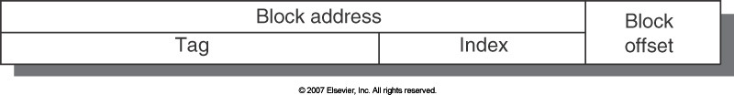


Example
k=6 (i.e., 6 offset bits, 64 Bytes/block)
= 2bits: 4 Bytes/word + 4bits: 16 words/block
Cache size: 16KB = 2^{8=index} sets x 1 blk/set x 2^{6=4+2=offset} B/blk
Address (showing bit positions)
31 14 13 6 5 2 1 0
18 bits 8 bits
1-way direct-mapped cache
6 bits
Hit
Tag
18
8
4
Byte offset
Data
Index➔cache set
- location of all possible blocks
Index
Block offset
18 bits
512 bits
V Tag
Data
Must check tag for each block:
- No need to check index, offset bits
256
entries
16
18
32
32
32
If increases associativity,
- shrinks index &
=
Mux
Select word among
expands tag size
32
16 words in a block
Bits Fields in Memory address used to access “Cache word”
Notes:
Block size: 64 bytes
Block offset: 6 bits
Number of blocks: 16KB / 64 bytes = 256 blocks
Index size = 8 bits
Tag size: 32 – 8 – 6 = 18 bits

Slide 57
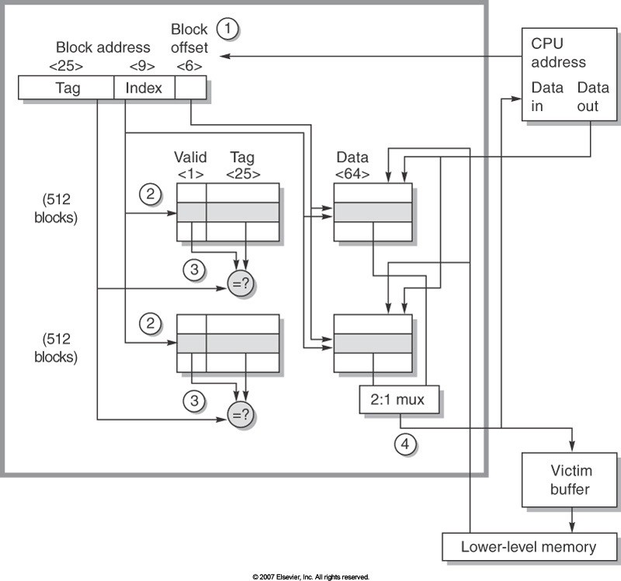
Review Question
block size (2-way set associative)
What is the size of a block in bytes?
Notes:
Block offset: 6 bits
Block size = 2^6 bytes = 64 bytes

Slide 58
Review Question
number of sets (2-way set associative)
What is the number of sets?
Notes:
Index size: 9 bits
Number of sets: 2^9 sets = 512 sets

Slide 59
Review Question
number of blocks (2-way set associative)
How many blocks?
Notes:
Number of blocks = 512 * 2 = 1024

Slide 60
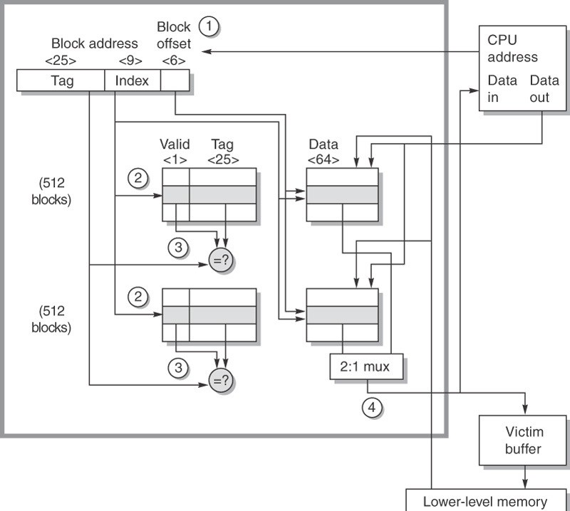
Example: Opteron
Opteron 64-bit microprocessor (2003)
2-way set associative cache
6 block offset bits (i.e., 64 Bytes/block)
= 3bits: 8 Bytes/word + 3bits: 8 words/block Cache size
= 64KB (2^{9=index} sets x 2 blk/set x 2^{6=3+3=offset} B/blk)
Select block
Notes:
Based on Figure B.5 from Appendix B (page B-13)
>>
Here is an example of data cache organization in the Opteron microprocessor.
The 64 KB cache is two-way set associative with 64-byte blocks.
Block size: 64 bytes
Block index: 6 bits
3 bits: 8 bytes / word, 3 bits: 8 words / block
Cache size: 64KB
Number of blocks = 1024 or 2^10 blocks
A 9-bit index selects among 512 sets.
3 bits of the block offset join the index to supply the
RAM address to select the proper 8 bytes.
Thus, the cache holds two groups of 4096 64-bit words,
with each group containing half of the 512 sets.
The line from lower-level memory to the
cache is used on a miss to load the cache.
The size of address leaving the processor is 40 bits
because it is a physical address and not a virtual address.

Slide 61
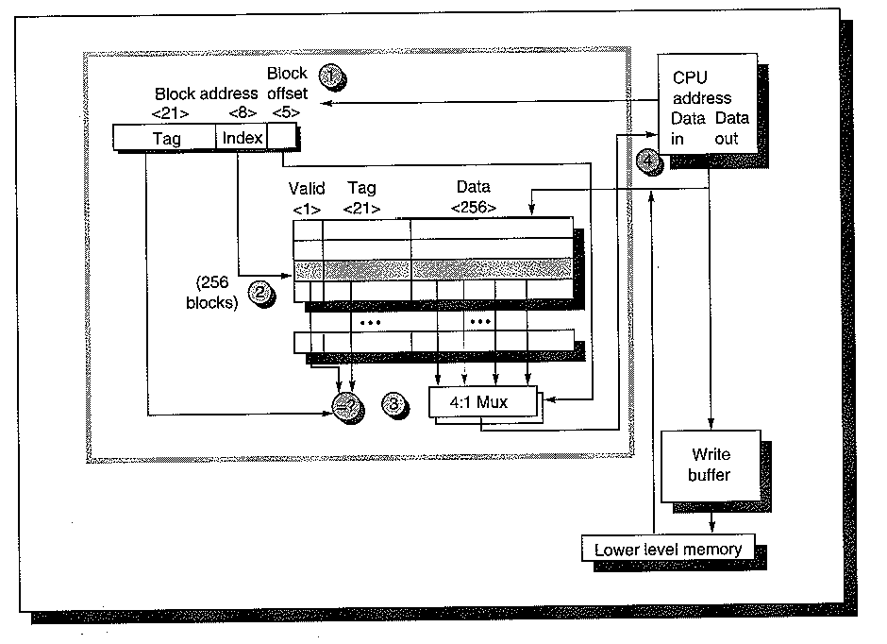
Example: Alpha 21064
Alpha 21064 (1992~)
Direct mapped
5 block offset bits (i.e., 32 Bytes/block)
= 3bits: 8 Bytes/word + 2bits: 4 words/block Cache size: 8KB = 2^{8=index} sets x 1 blk/set x 2^{5=3+2=offset} B/blk
Select cache word

